Slide 1


Slide 2
ANSWER THE FOLLOWING QUESTIONS
1. WHY ARE YOU HERE? R//: I am here because I want to learn more and improve my knowledge.
2. WHAT DO YOU WANT TO BE?
R//: I want to be a better programmer, I want to be a great professional and a better person
3. WHAT DO YOU WANT TO DO?
R//: I want to make improvements in my personality, I want to improve my knowledge and fulfill my achievements
4. WHAT DO YOU WANT TO HAVE?
R//: I want to have the best attitude to improve my abilities and be a better person.
5. WHAT DO YOU WANT TO SHARE? R//:I want to share my knowledge and teach what I have learned

Slide 3

1. Learning
Focused vs. diffuse thinking
Deliberate practice

Slide 4
Focused thinking:
Focused thinking is a highly attentive state of mind in which the brain uses its best concentration skills in the prefrontal cortex to ignore all extraneous information. During focused thinking, we concentrate completely on what we want to learn or learn. To achieve this, we usually need silence, review the concepts repeatedly and even recite them out loud to memorize them.
Example:
Logical thinking: It involves starting from confirmed premises to reach conclusions through deduction and induction. For example, if I save a little each day, at the end of the month I will have enough money to buy something specific. Or if I don't sleep well during the week, I'll be tired on Friday.
Creative thinking: Moves away from the usual and looks for unique and original solutions. For example, thinking about other functions for an object beyond its conventional use.
Traditional thinking: Mainly uses logic and seeks solutions based on past experiences. For example, applying strategies that helped us overcome anxiety in the past to face similar situations in the present.
Practical thinking: Helps us find useful concepts or solutions in everyday situations. For example, choosing the shortest route to work when we are in a hurry, even if it is less scenic.
Analogical thinking: Organize ideas and compare elements of reality. It is similar to logical thinking but focuses on comparisons. For example, analyze how different elements relate to each other.

Slide 5
Activity for focused thinking
In this activity, we will use a Rubik's Cube to exercise focused thinking. The Rubik's Cube is a puzzle that requires concentration and problem-solving skills to solve. By focusing on manipulating the cube's colored squares and finding a solution, participants will practice concentrating on a specific task without distractions. This activity helps improve concentration, problem-solving abilities, and perseverance, all of which are essential aspects of focused thinking.

Slide 6
diffuse thinking:
Fuzzy thinking is a way of processing information that allows us to look at the big picture. Unlike focused thinking, diffuse thinking is about distractions and random connections.
Example:
Cooking: While preparing a recipe, your mind may wander and make random connections. Maybe you're thinking about alternative ingredients or how to improve the flavor.
Enjoying the landscape: When you observe a beautiful landscape, such as a sunset or a field of flowers, your mind relaxes and can form creative ideas or reflect on other topics.
Listening to music: During a song, your mind may wander and associate the lyrics with personal experiences or abstract thoughts.
Do any physical activity: When running, swimming or exercising, your brain has the opportunity to process information more holistically and find unexpected solutions.
Sleep: Although it may seem surprising, diffuse thinking also occurs while we sleep. Our brain processes memories, organizes ideas and creates connections during sleep

Slide 7
Activity for diffuse thinking
In this activity, participants engage in visual art creation, such as drawing or painting, to exercise diffuse thinking. Visual art provides a medium for individuals to express themselves creatively and explore ideas in a non-verbal way. Through the act of creating art, participants are encouraged to let their minds wander, experiment with different techniques, and explore various concepts and themes. This process stimulates divergent thinking and encourages the exploration of new perspectives and interpretations. Additionally, visual art allows for the expression of emotions and experiences, fostering a deeper connection with oneself and others.

Slide 8
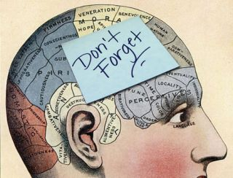
2. Memory
Spaced repetition
Mnemonics

Slide 9
Spaced repetition:
Spaced repetition, also known as spaced review, is a rote learning technique that consists of learning specific material by allowing increasingly longer periods of time to pass between one training session and the next.
Example:
Learn vocabulary in a foreign language:
If you want to learn new vocabulary in a foreign language, you could schedule the review of the words you studied for the next day, the second review in three days, the third in a week, the fourth in a month, and so on.
Study for a test:
Use spaced repetition to review study material. For example, check a card the next day, then after three days, one week, two weeks, etc. Prioritize review of the most difficult cards
Memorize mathematical formulas:
If you need to remember math formulas, establish a spaced-out review schedule. Every time you practice, you reinforce your memory and retention of the formulas
Learn history or important dates:
If you're studying history or significant events, schedule spaced reviews to remember key dates, character names, and important details.
Practice musical or sports skills:
Spaced repetition also works to improve practical skills. For example, if you play a musical instrument or play a sport, schedule practice sessions with increasing intervals between them.

Slide 10
Activity for Spaced repetition
Activity Description:
In this activity, participants will engage in a spaced repetition practice using memory cards. Spaced repetition is a learning technique that involves reviewing material at increasing intervals over time to enhance long-term retention.
Instructions:
Create Memory Cards: Provide participants with sets of memory cards. Each card should feature a question or concept on one side and its corresponding answer on the other.
Study Session: Instruct participants to review the memory cards systematically. Start by reviewing all the cards, then separate them into two stacks: one for cards they answer correctly and one for cards they answer incorrectly.
Spaced Review: After the initial study session, have participants review the cards they answered incorrectly more frequently than those they answered correctly. Encourage them to revisit the incorrect cards at shorter intervals, gradually spacing out the review sessions as they become more proficient.
Self-Assessment: Prompt participants to assess their understanding of each card after reviewing it. They can rate their confidence level or indicate whether they answered correctly or incorrectly.
Progressive Review: As participants continue to study, adjust the intervals for reviewing the cards based on their performance. Cards that are consistently answered correctly can be reviewed less frequently, while cards that pose more difficulty can be reviewed more frequently.

Slide 11
Mnemonics:
Mnemonics, or mnemonics, is a technique used to improve memory and facilitate the recall of information by associating the information to be remembered with images, phrases, acronyms or any other type of mnemonic aid. Here are five practical examples of mnemonic techniques:
Acronyms:
Example: "ROY G. BIV" to remember the colors of the rainbow (Red, Orange, Yellow, Green, Blue, Indigo, Violet).
Explanation: The first letters of each word are used to form an acronym that represents the color sequence.
Image association:
Example: To remember a shopping list that includes apples, milk, bread, and eggs, imagine a vivid, whimsical image that combines all the items together.
Explanation: The association of images creates a visual connection between the elements that you want to remember, facilitating their retrieval in memory.
Keywords:
Example: To remember the word "kind" in French (gentle), you can associate it with the image of a kind person offering a cup of tea.
Explanation: A key word or image is selected that has a phonetic or semantic relationship with the word or concept you want to remember in another language or context.
Loci method (method of places):
Example: To remember a to-do list, imagine a route you take frequently, like your house. Associate each task with a specific location on that route.
Explanation: This method takes advantage of spatial memory by associating each element to be remembered with a familiar physical place, facilitating its recovery by mentally visualizing the route.
Rhymes or songs:
Example: "September has thirty days, with April, June and November..."
Explanation: Repeating a rhyme or song with specific information helps you remember sequences of data, such as the number of days in each month of the year.

Slide 12
Activity: Memory Palace Exercise
Description:
In this activity, participants will practice the Memory Palace technique, also known as the Loci method, which involves associating items to remember with specific locations in a familiar place, such as their house.
Instructions:
Select a Familiar Location: Have participants choose a familiar location, such as their house or school, to use as their memory palace.
Associate Items with Locations: Ask participants to create a list of items they want to remember, such as a grocery list or a list of historical events. Then, instruct them to mentally place each item in a specific location within their memory palace.
Visualize Associations: Encourage participants to vividly visualize each item in its corresponding location within their memory palace. They can imagine interacting with the items or creating memorable associations between the items and the locations.
Review and Recall: After a short period of time, have participants recall the items from their memory palace. Encourage them to mentally walk through their memory palace and retrieve each item based on its location.
Reflect and Discuss: Facilitate a discussion where participants share their experiences with using the Memory Palace technique. Encourage them to discuss the effectiveness of the technique and any challenges they encountered.

Slide 13

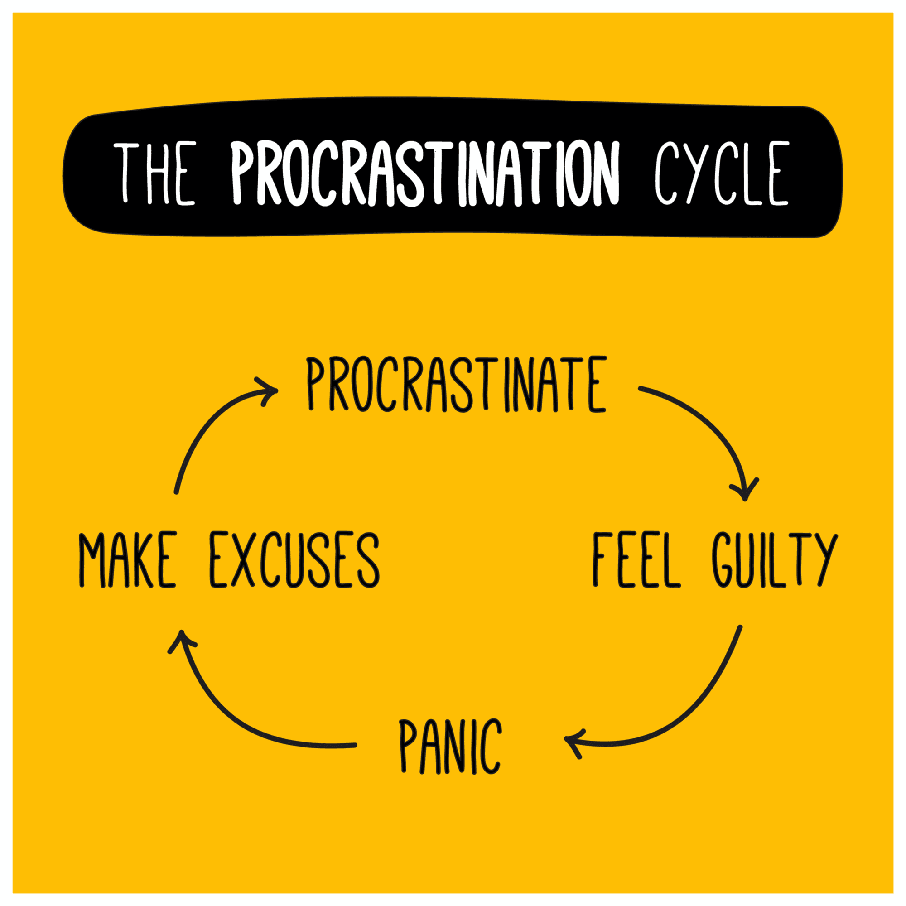
3- Procrastination
Pomodoro technique
Zeigarnik

Slide 14
Pomodoro technique:
The Pomodoro Technique is a time management method that uses short, focused intervals of time to improve productivity. It involves working on a task for a predetermined period of time (usually 25 minutes), followed by a short break (usually 5 minutes). After completing four consecutive "pomodoros", you take a longer break of approximately 15-30 minutes.
Practical Examples:
Studying for an Exam:
Use the Pomodoro technique to study for an exam by focusing on studying for 25 minutes, followed by a 5-minute break. Repeat this cycle to cover multiple topics.
Writing a Report:
Break down the writing process into Pomodoros, working on the report for 25 minutes at a time, followed by a short break to rest your mind. Continue until you finish a section or reach your goal.
Cleaning and Organizing:
Use Pomodoros to tackle cleaning and organizing tasks. Work on decluttering for 25 minutes, then take a 5-minute break. Repeat until you've completed a specific area or task.
Learning a New Skill:
Practice a new skill, such as coding or playing an instrument, using Pomodoros. Focus on learning for 25 minutes, followed by a short break. Repeat to reinforce learning.
Working on a Project:
Break down a project into manageable tasks and work on them using Pomodoros. Focus on one task for 25 minutes, then take a break before moving on to the next task.

Slide 15
Activity: Pomodoro Study Session
Description:
In this activity, participants will engage in a Pomodoro study session to experience the effectiveness of the Pomodoro technique in improving focus and productivity.
Instructions:
Set Up: Divide participants into pairs or small groups. Each group will need a timer (such as a smartphone timer or an online Pomodoro timer).
Choose a Task: Have each group choose a study topic or task they want to work on during the Pomodoro session.
Pomodoro Session: Set the timer for a 25-minute Pomodoro session. During this time, participants will focus solely on their chosen task, without any distractions.
Break: After the 25 minutes are up, set a 5-minute break for participants to rest and recharge.
Reflect and Rotate: After the break, have participants reflect on their productivity during the Pomodoro session. Then, rotate roles within the group, allowing each member to take turns being the timer setter and the task performer.
Repeat: Repeat steps 3 to 5 for several Pomodoro sessions, alternating between focused work and short breaks.
Discussion: At the end of the activity, facilitate a group discussion where participants share their experiences with the Pomodoro technique. Encourage them to discuss its effectiveness in helping them stay focused and productive.

Slide 16
Zeigarnik:
The "Zeigarnik effect" is a psychological phenomenon that suggests that people remember incomplete or interrupted tasks better than completed tasks. It was discovered by Russian psychologist Bluma Zeigarnik in the 1920s. This theory postulates that tasks or activities left unfinished generate a feeling of mental tension, causing the brain to keep them active in memory until they are completed.
Practical Examples:
Incomplete To-Do List: When you make a to-do list, you are more likely to remember the tasks that have not yet been completed compared to the ones you have already marked as done. This can motivate you to go back and complete those pending tasks.
TV Series or Streaming Shows: If you're watching a TV series or streaming show and you stop watching an episode halfway through, you'll likely have greater retention of details from that episode compared to those you already watched. has finished watching.
Studying and projects: When studying for an exam or working on a project, you are likely to remember better topics or tasks that you have not yet mastered or completed. This feeling of "mental tension" can motivate you to devote more time and effort to those areas.
Games and puzzles: If you leave a game or puzzle unsolved, your mind is more likely to keep thinking about it even when you're not actively playing. This may motivate you to go back and solve the game or puzzle.
Interrupted conversations: When a conversation is abruptly interrupted or left unresolved, you are more likely to remember the topics or points that were left undiscussed. This may lead you to return to the conversation in the future to complete it.

Slide 17
Activity: Unfinished Tasks Reflection
Description:
In this activity, participants will reflect on the unfinished tasks they have and explore how the Zeigarnik effect influences their memory and motivation.
Instructions:
Task Identification: Have participants identify one or more tasks they have left unfinished. These tasks could be from work, school, personal projects, or any other aspect of their lives.
Reflection Questions: Ask participants to reflect on the following questions:
How do you feel about the unfinished tasks on your list?
Do you find yourself thinking about these tasks frequently?
How does the unfinished nature of these tasks affect your motivation and productivity?
Group Discussion: Facilitate a group discussion where participants share their reflections and experiences. Encourage them to discuss how the Zeigarnik effect manifests in their lives and how it impacts their behavior and mindset.
Goal Setting: Encourage participants to set specific goals or action steps to address their unfinished tasks. Emphasize the importance of breaking down tasks into smaller, manageable steps to reduce the impact of the Zeigarnik effect.
Follow-Up: Follow up with participants at a later time to see if reflecting on the Zeigarnik effect has influenced their approach to completing tasks and managing their workload.

Slide 18
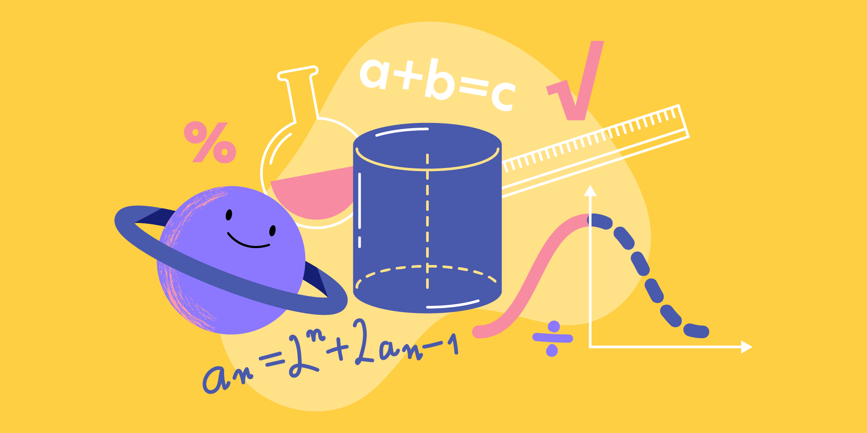
4.Math and Science
Problem-solving techniques
Math

Slide 19
Problem-solving techniques:
Problem solving techniques are systematic methods for finding effective solutions to challenges. They help identify, analyze and solve problems efficiently.
Examples:
Root cause analysis:
Identify the root cause of a problem.
Brainstorming:
Generate ideas without criticism to address a problem.
Ishikawa's diagram:
Organize potential causes of a problem into categories.
Scientific method:
Formulate hypotheses, collect data and reach conclusions.
5W1H method:
Ask key questions (who, what, when, where, why and how) to understand a problem.

Slide 20
Activity: Problem-Solving Challenge with Riddle
Description:
In this activity, participants will work on a problem-solving challenge using a riddle as a starting point.
Instructions:
Group Formation:
Divide the participants into small groups of approximately 3-4 people.
Presentation of the Riddle:
Present each group with the following riddle: Riddle: "A farmer has a wolf, a goat, and a cabbage. He needs to cross a river in a boat that can only carry him and one of his three possessions at a time. However, if he leaves the wolf and the goat alone on the shore, the wolf will eat the goat. If he leaves the goat and the cabbage alone on the shore, the goat will eat the cabbage. How can the farmer cross the river with all his possessions intact?"
Application of Techniques:
Each group must apply a specific problem-solving technique to address the riddle. They can choose from techniques such as root cause analysis, brainstorming, Ishikawa diagram, scientific method, among others.
Riddle Resolution:
Groups work together to solve the riddle using the selected technique. They should discuss different approaches, consider various solutions, and come to a conclusion.
Solution Presentation:
After a designated time, each group presents their approach and solution to the rest of the class. They should explain how they applied the problem-solving technique and why they chose that particular strategy.

Slide 21
MATH::
Math refers to the specific strategies and methods used to facilitate the understanding and mastery of mathematical concepts.
Practical examples:
Problem Solving Strategies:
Teach students different approaches to approaching and solving mathematical problems, such as trial and error, identifying patterns, and applying algorithms.
Use of Visual Resources:
Use visual tools such as graphs, diagrams, and models to help students visualize abstract mathematical concepts, thus facilitating their understanding.
Regular Practice and Repetitive Exercises:
Provide students with regular opportunities to practice mathematical skills through repetitive exercises and practice problems, helping them consolidate and reinforce what they have learned.
Teaching Based on Real World Problems:
Integrate real-world problems into mathematics teaching, allowing students to apply mathematical concepts in relevant contexts and understand the usefulness and applicability of mathematics in everyday life.
Collaboration and Teamwork:
Encourage collaboration and teamwork among students when solving mathematical problems, allowing them to learn from each other, develop communication skills, and work together to find solutions.

Slide 22
Activity: Mental Addition and Subtraction
Description:
In this activity, participants will practice mental addition and subtraction while solving simple problems.
Instructions:
Pairing:
Divide the participants into pairs. Each pair will work together on the activity.
Problem Generation:
Each pair should create a list of addition and subtraction problems for the other pair to solve. The problems should be simple and tailored to the participants' skill level.
Problem Exchange:
Pairs exchange their lists of problems with another pair.
Problem Solving:
Each pair solves the problems they received from the other pair. They can work together to find the correct answers.
Answer Verification:
After solving the problems, pairs verify the answers with each other to ensure correctness.
Discussion and Reflection:
At the end of the activity, facilitate a class discussion where participants share their experiences, the strategies they used to solve the problems, and the importance of mathematical skills in everyday life.

Slide 23
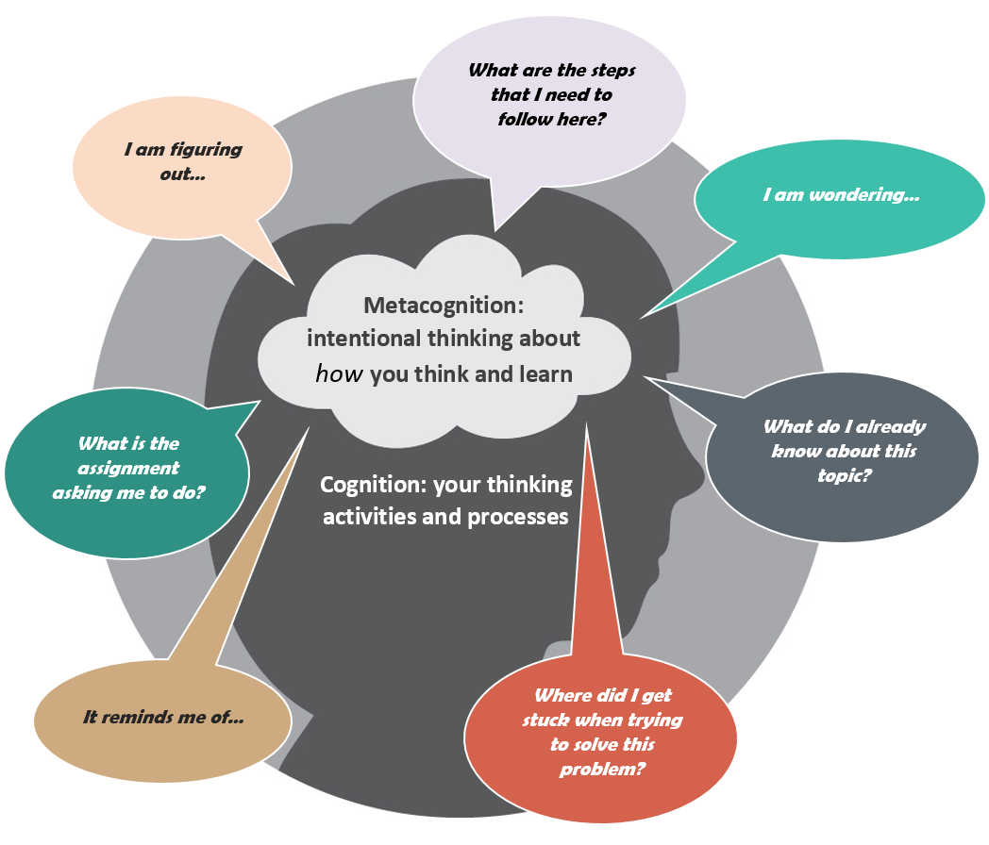
5. Metacognition
Learning style
Self-monitoring

Slide 24
Technique: Learning Styles
Explanation:
Learning styles refer to individual preferences and characteristic approaches that people use to learn new information and skills. Recognizing and understanding learning styles can help students optimize their learning process by tailoring study strategies and learning activities to their individual preferences.
Practical Examples:
Visual:
A visual learner may prefer using diagrams, charts, and mind maps to organize information and understand complex concepts.
Auditory:
An auditory learner may benefit from verbal repetition of information, such as listening to lecture recordings or discussing concepts aloud with others.
Kinesthetic:
A kinesthetic learner may learn best through active practice and physical manipulation of objects. For example, they may use gestures or body movements to memorize information or solve problems.
Reading/Writing:
A student with a reading/writing learning style may prefer reading texts and writing summaries or detailed notes as the primary method for processing and remembering information.
Global/Analytical:
Some learners may have a preference for global learning, which involves understanding the big picture before delving into details, while others may prefer a more analytical approach, breaking down information into smaller parts for better understanding.

Slide 25
Activity: "Exploring Our Learning Styles"
Description:
This activity aims to have participants explore and reflect on their individual learning preferences.
Instructions:
Learning Styles Questionnaire:
Provide each participant with a brief questionnaire about learning styles. You can find simple questionnaires online that will help identify each individual's preferences (you can search for "learning styles questionnaire" online).
Individual Analysis:
Once the questionnaire is completed, ask participants to review their results and reflect on the learning preferences identified in themselves. Do they identify more with visual, auditory, kinesthetic learning, etc.?
Group Discussion:
Facilitate a group discussion where participants share their results and experiences. Encourage sharing how they believe these preferences may influence their study and learning approach.
Practical Activities:
Divide participants into small groups based on their predominant learning styles (e.g., visual, auditory, kinesthetic).
Visual: Provide visual material such as charts or diagrams for them to analyze and discuss.
Auditory: Conduct an activity involving listening and discussion, such as storytelling or listening to a recording.
Kinesthetic: Provide a hands-on activity that requires movement or physical manipulation, such as a role-playing game or simulation.
Final Reflection:
At the end of the activities, ask participants to reflect on how they felt participating in activities designed for their learning style and how they believe this may influence their learning process in the future.

Slide 26
Technique: Self-Monitoring
Explanation:
Self-monitoring is the ability of individuals to observe, evaluate and regulate their own learning and understanding process.
Practical examples:
Study Time Record: Keep track of time spent studying and review to improve time management.
Comprehension Self-Assessment: Reflect on what you have learned after a study or reading session.
Personal Goal Setting: Set specific academic goals and monitor progress toward them.
Use of Learning Strategies: Experiment with different study techniques and evaluate their effectiveness.
Post-Exam Reflection: Review answers after an exam to identify areas for improvement.

Slide 27
Activity: Self-Monitoring Journal
Description:
In this activity, students will keep a self-monitoring journal to record and reflect on their learning and understanding process.
Instructions:
Creating the Journal:
Provide each student with a notebook or digital document where they can keep track of their academic progress.
Daily Recording:
Each day, students should spend a few minutes recording their study activities, including the time spent, the strategies used, and the goals achieved.
Reflection and Evaluation:
At the end of each week, students should review their journal and reflect on their progress. They can assess which strategies were effective, identify areas for improvement, and set goals for the next week.
Adjusting Strategies:
Based on their weekly reflection, students should adjust their study strategies as needed. They can experiment with new techniques and observe how they impact their performance.
Continuous Monitoring:
Students should continue to record their activities and reflect on their learning process regularly to stay focused on their goals and progress consistently.

Slide 28

6. Productivity
Time management
Goal setting

Slide 29
Technique: Time Management
Explanation:
Time management is a productivity technique that involves efficiently planning and organizing how available time is utilized to maximize productivity and achieve set goals. This includes identifying priority tasks, allocating appropriate time to each task, and minimizing distractions.
Practical Examples:
Creating a Schedule:
Developing a detailed schedule for each day of the week, allocating specific time blocks for activities such as study, work, exercise, and rest.
Using Pomodoro Technique:
Applying the Pomodoro technique, which involves working in short time intervals (e.g., 25 minutes) followed by brief breaks (e.g., 5 minutes) to maintain focus and efficiency.
Task Prioritization:
Using techniques like the Eisenhower matrix to categorize tasks based on their importance and urgency, helping prioritize and focus on the most meaningful activities.
Eliminating Distractions:
Identifying and eliminating distractions such as social media, email notifications, or text messages during designated periods of concentrated work.
Delegating Tasks:
Recognizing tasks that can be delegated to others and assigning them based on the skills and availability of team members, thereby freeing up time to focus on key responsibilities.

Slide 30
Activity: Daily Task Planning
Description:
In this activity, participants will carry out daily task planning using time management principles.
Instructions:
Creating a Task List:
Each participant should make a list of the tasks they need to complete during the day. They can include personal, academic, or work-related tasks.
Task Prioritization:
Participants should prioritize the tasks on their list based on their importance and urgency. They can use techniques like the Eisenhower matrix to assist in this process.
Time Allocation:
Once tasks are prioritized, participants should assign an estimated time to complete each one. It's important to be realistic and consider the time needed for each task.
Creating a Schedule:
Using a calendar or planner, participants should create a detailed schedule that includes the prioritized tasks and the allocated time for each. They should also ensure to include time for breaks and personal activities.
Tracking and Adjusting:
Throughout the day, participants should follow their schedule and record the time spent on each task. If any unexpected events occur or more time is needed for a task, they can adjust their schedule accordingly.

Slide 31
Technique: Goal Setting
Explanation:
Goal setting is a productivity technique that involves defining specific, measurable objectives to guide work and personal or professional progress. These goals provide clear direction and motivate people to focus on relevant and achievable tasks.
Practical examples:
Short Term Objectives:
Set daily, weekly or monthly goals that can be achieved in a defined period of time. For example, completing a small project this week.
Long-term goals:
Define long-term goals that span months or years and represent significant achievements. For example, obtaining a professional certification in a specific field within a year.
Personal goals:
Identify goals related to personal growth, such as learning a new language, improving physical fitness, or developing artistic skills.
Professional goals:
Set professional goals that drive career growth, such as getting a promotion, increasing sales by a certain percentage, or leading an important project.
SMART Goals:
Apply the SMART (Specific, Measurable, Attainable, Relevant and Time-bound) approach to establish effective, well-defined goals that are clear and easily evaluable.

Slide 32
Activity: Creating a Vision Board
Description:
In this activity, participants will create a vision board to visualize and define their goals using the goal-setting technique.
Instructions:
Preparing Materials:
Provide each participant with a large cork board, cardboard, or canvas, as well as magazines, printed images, stickers, markers, scissors, and glue.
Defining Goals:
Ask participants to reflect on their short and long-term personal or professional goals. They should identify specific objectives they wish to achieve in different aspects of their lives.
Selecting Images:
Participants should search through magazines or print out images that visually represent their goals and aspirations. These can be pictures of places, people, inspiring words, or symbols that evoke their goals.
Creating the Board:
Invite participants to creatively glue the selected images onto their vision board. They can organize the images by categories or create sections for different areas of their lives.
Reflection and Commitment:
Once the board is complete, participants should take a moment to reflect on each image and how it relates to their goals. They can write brief descriptions or affirmations related to each image.
Regular Visualization:
Encourage participants to place their vision board in a visible place where they can see it every day. It will remind them of their goals and motivate them to take concrete steps towards their realization.

